Slide 1


LARGE LANGUAGE MODEL ON FPGA

Slide 2
CONTENTS:
Large language model
Flight Large language model
Transformer Architecture
Different large language model
Comparison between CPU,GPU,FPGA
Testing its feasibility by trying to implement a tiny BERT LLM on a Zedboard (Zynq-7000 ARM)
Local LLMs

Slide 3
What is Large language Model?
AI algorithm that applies neural network techniques
Ex: chat GPT,BERT,LLAMA
We started to look into Tiny BERT model and started learning about transformer architecture
And later we started reading about Flight LLMs which was implemented on Alveo U280 FPGA.

Slide 4
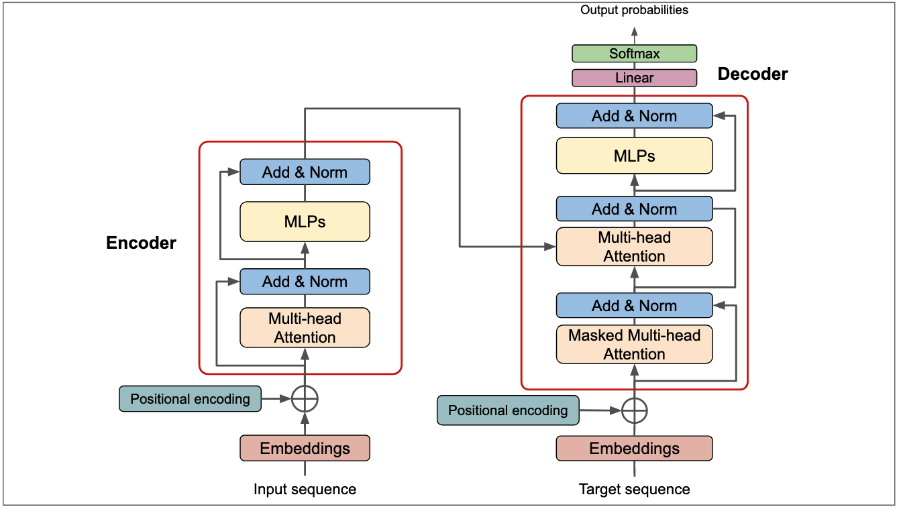
TRANSFORMER ARCHITECTURE
Self-Attention Mechanism
Multi-Head Attention
Positional Encoding
Feedforward Neural Networks (FFNs)
Layer Normalization and
Residual Connections

Slide 5
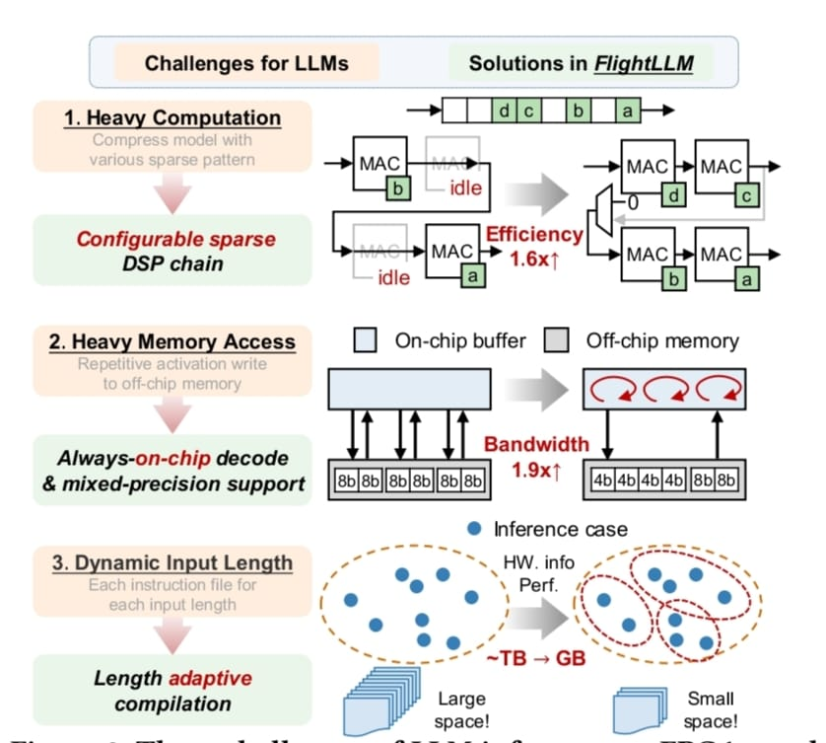
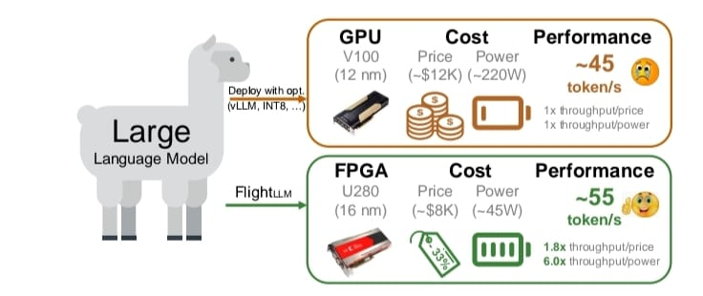
Flight LLM
In this this Large language model in Implemented on the Xilinx Alveo U280 FPGA
Flight LLM achieves 6 times energy efficiency and 1.8 time commercial cost efficiency against GPUs(NVIDIA V100s)

Slide 6
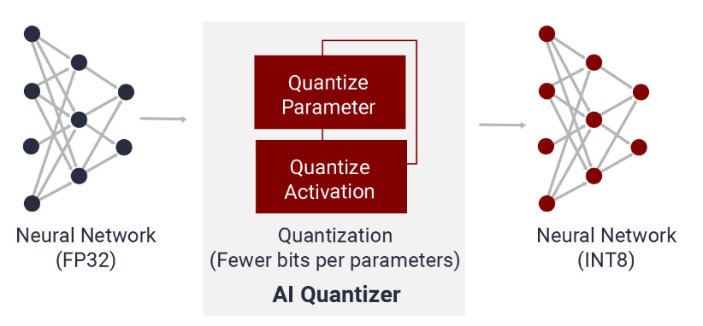
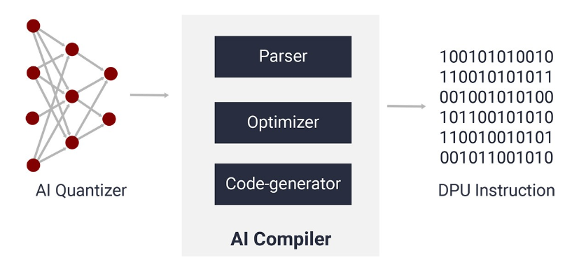
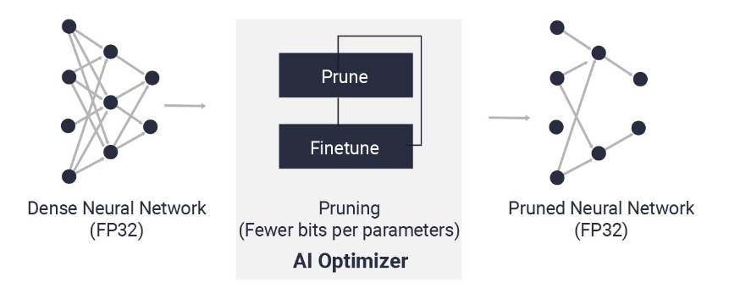
AMD Vitis AI
Tiny Bert quantized Model in ONNX Format
Vitis AI supports ONNX Runtime to be interfaced with many Development boards.
It makes quantization easier as there are high level libraries built for efficient AI interface with DPU cored.

Slide 7
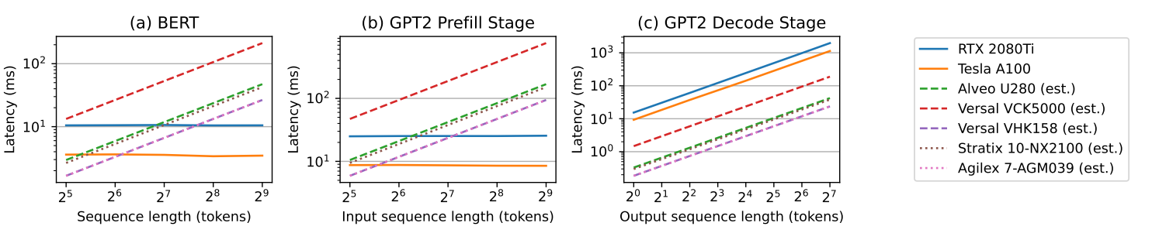
Metrics For Evaluation and Optimizations
Inference Time
Resource Utilization
Accuracy Metrics
Latency vs tokens
Heatmaps and Attention Maps

Slide 8
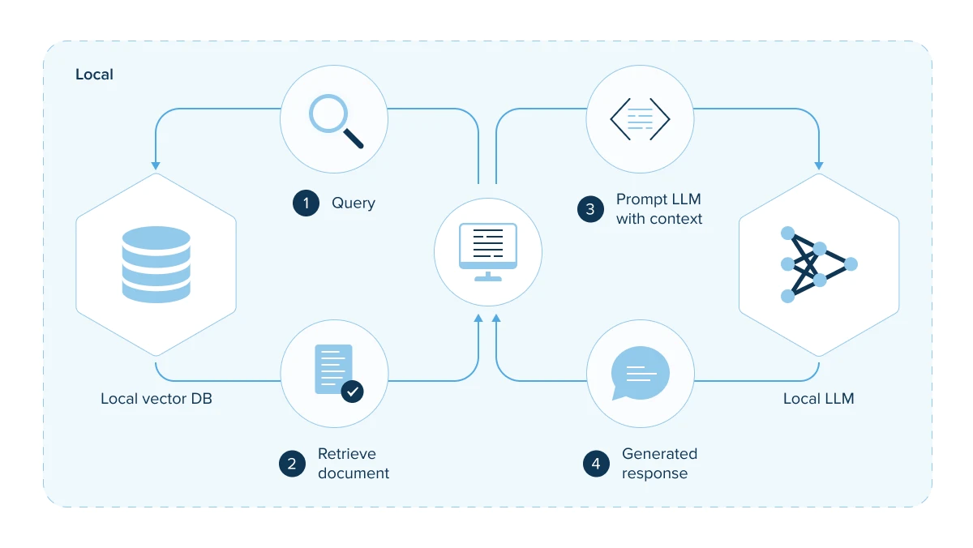
Local LLMs
Local LLMs can be a game changer by eliminating the need dependency on GPUs, you can unlock the full potential of LLMs for your application development needs.
Improved Data security as LLMs, prompts and responses stay within our system.
Easier to build applications using local LLMs.

